Slide 1

冒險故事 (Animaze)
Notes:
1. 目標 → 2. 阻礙 → 3. 努力 → 4. 結果 → 5. 意外 → 6. 轉彎 → 7. 結局

Slide 2

Notes:
我是一個

Slide 3
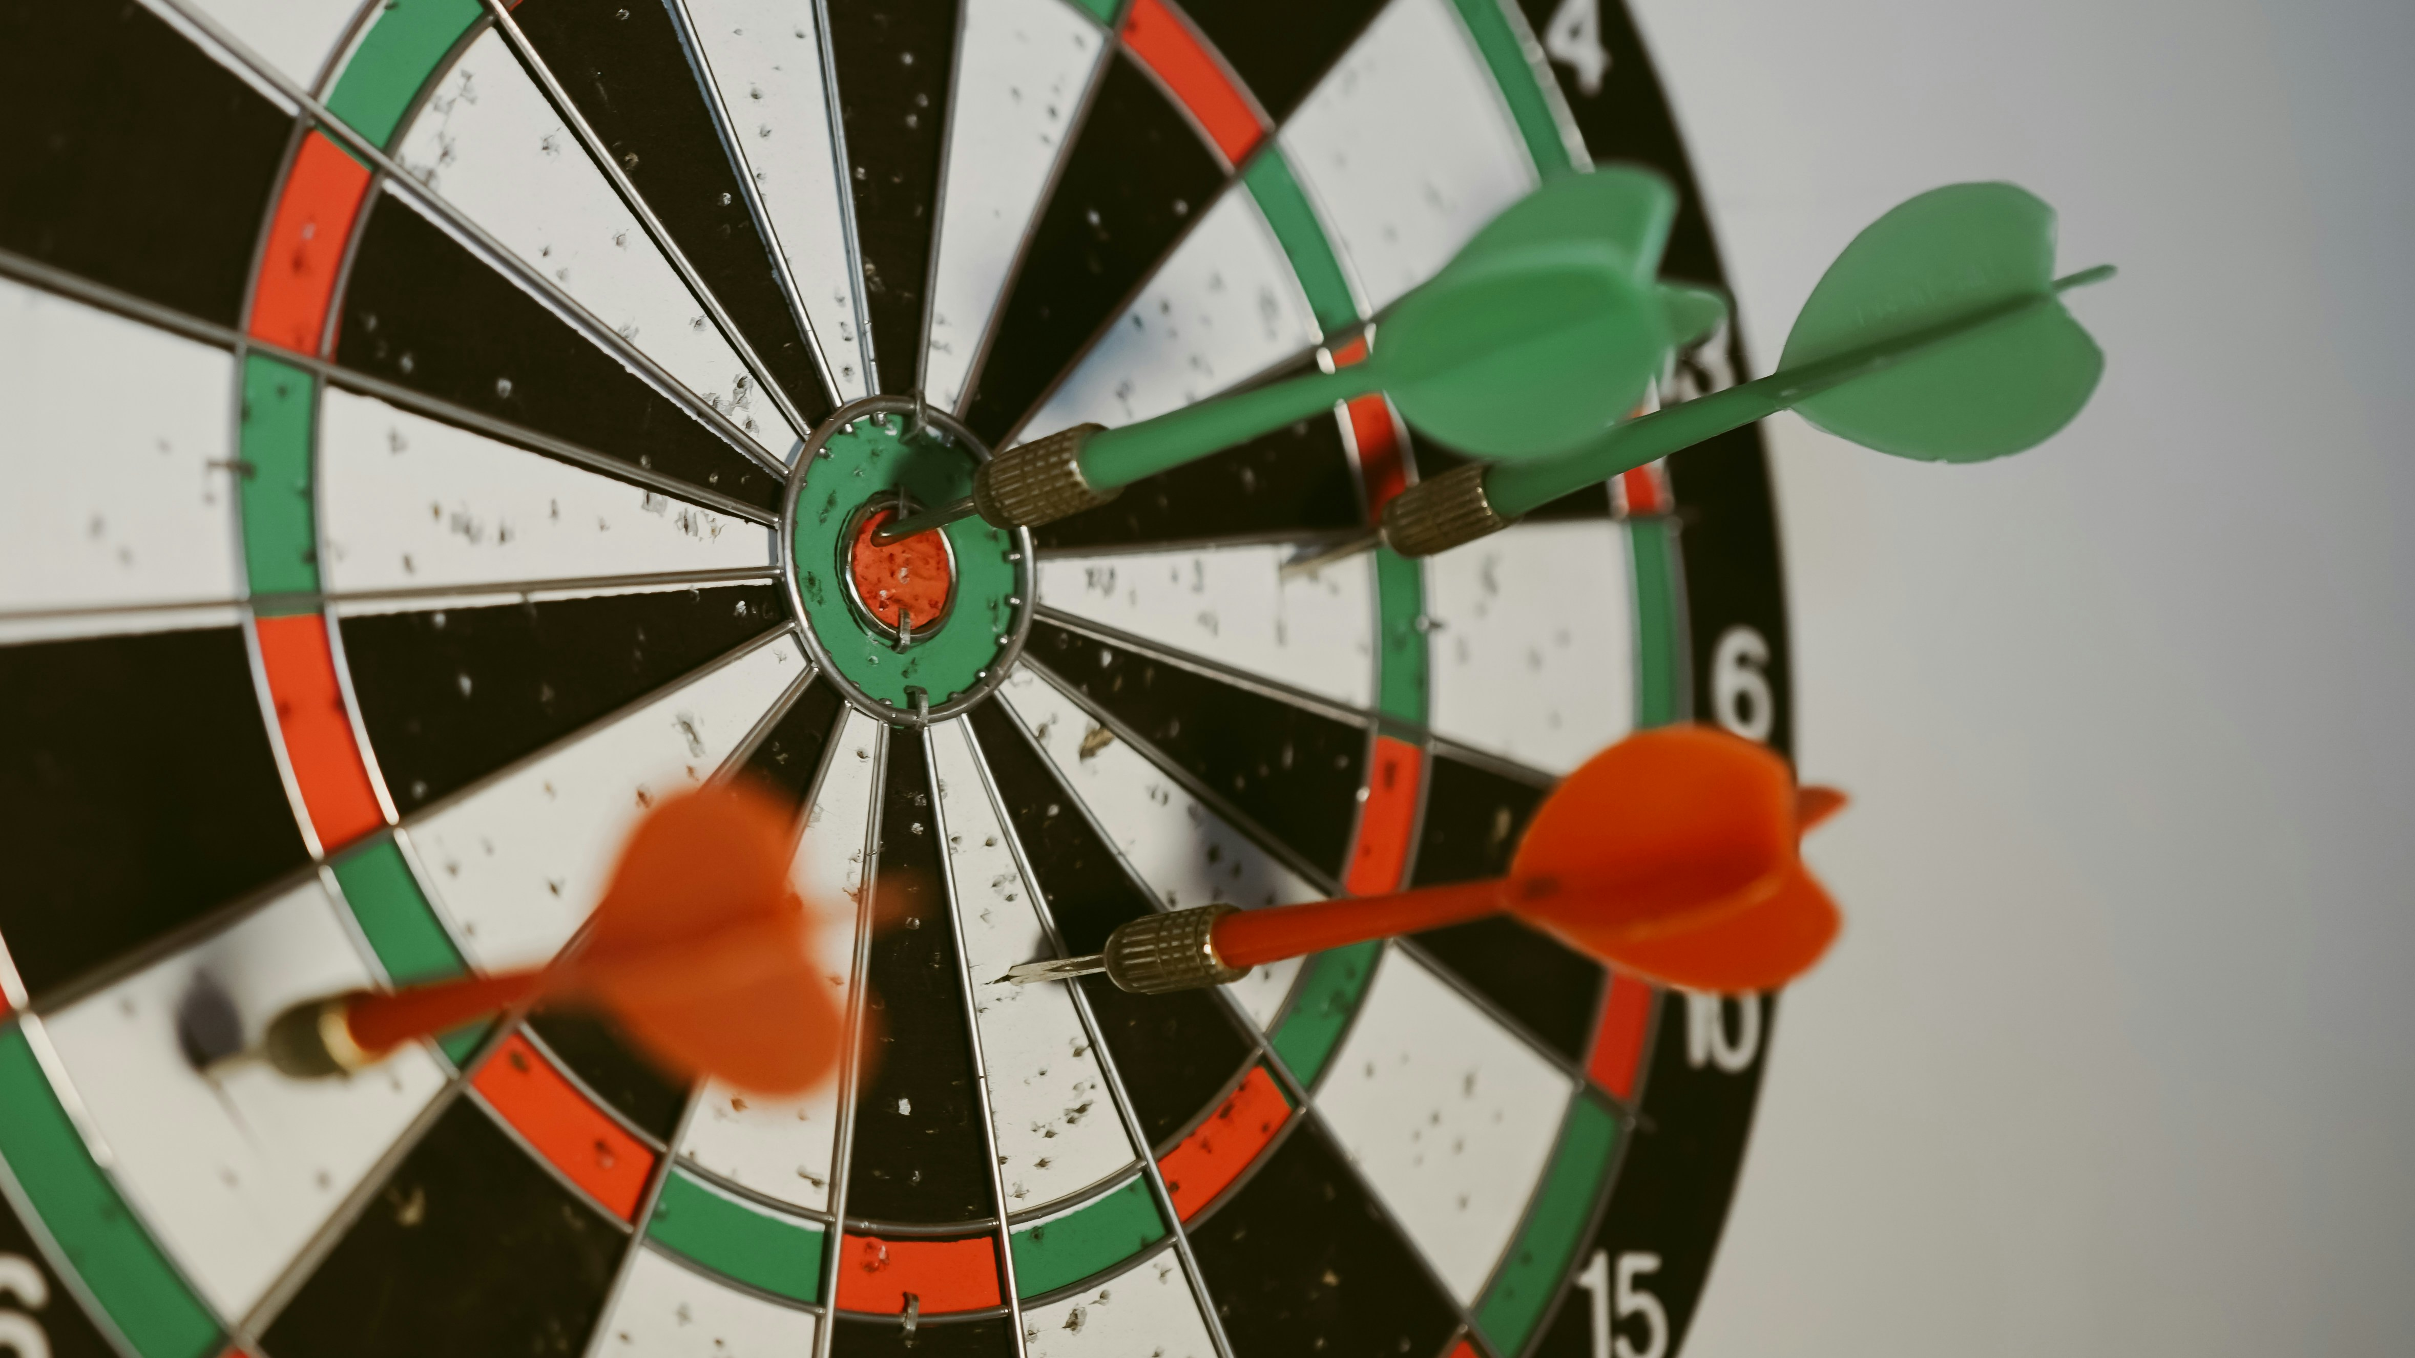
1. 目標

Slide 4

Notes:
https://unsplash.com/photos/woman-standing-on-top-of-hill-rJc1RioyERQ?utm_content=creditShareLink&utm_medium=referral&utm_source=unsplash

Slide 5
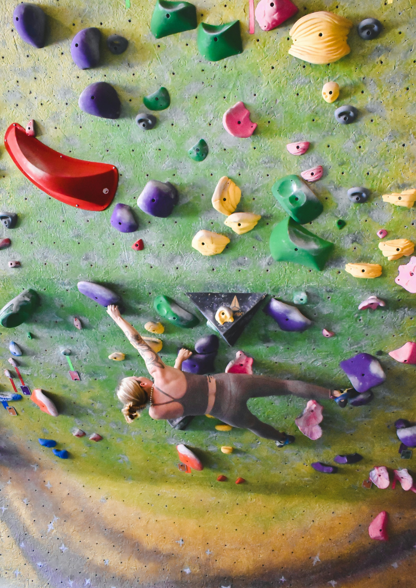


Notes:
https://unsplash.com/photos/woman-rock-climbing-inside-building-NY1D4Zni7fc?utm_content=creditShareLink&utm_medium=referral&utm_source=unsplash

Slide 6

2. 阻礙

Slide 7
Notes:
https://unsplash.com/photos/a-person-lying-on-the-ground-xVDPqJtasL8?utm_content=creditShareLink&utm_medium=referral&utm_source=unsplash

Slide 8

3. 努力

Slide 9
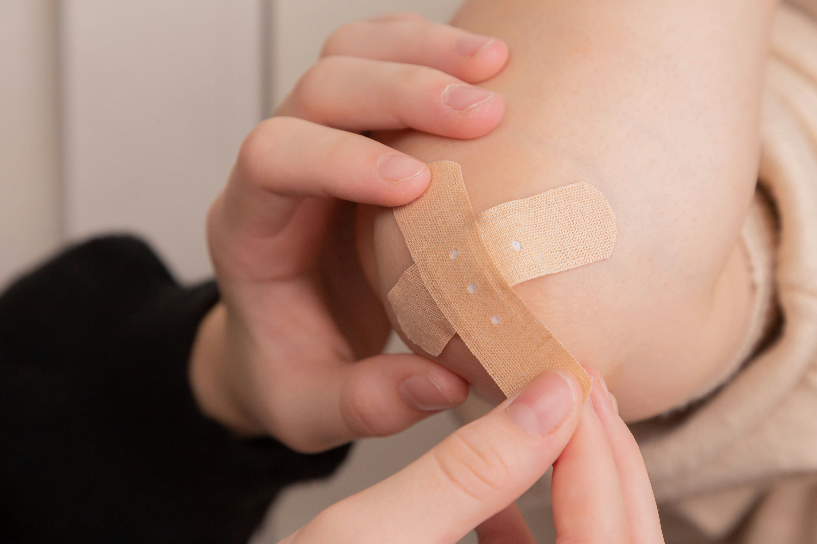
Notes:
https://unsplash.com/photos/person-holding-band-aid-on-left-hand-rKJoUsqmSs4?utm_content=creditShareLink&utm_medium=referral&utm_source=unsplash

Slide 10

Notes:
https://unsplash.com/photos/woman-sitting-and-leaning-forward-using-smartphone-boSYG0x_tBQ?utm_content=creditShareLink&utm_medium=referral&utm_source=unsplash

Slide 11
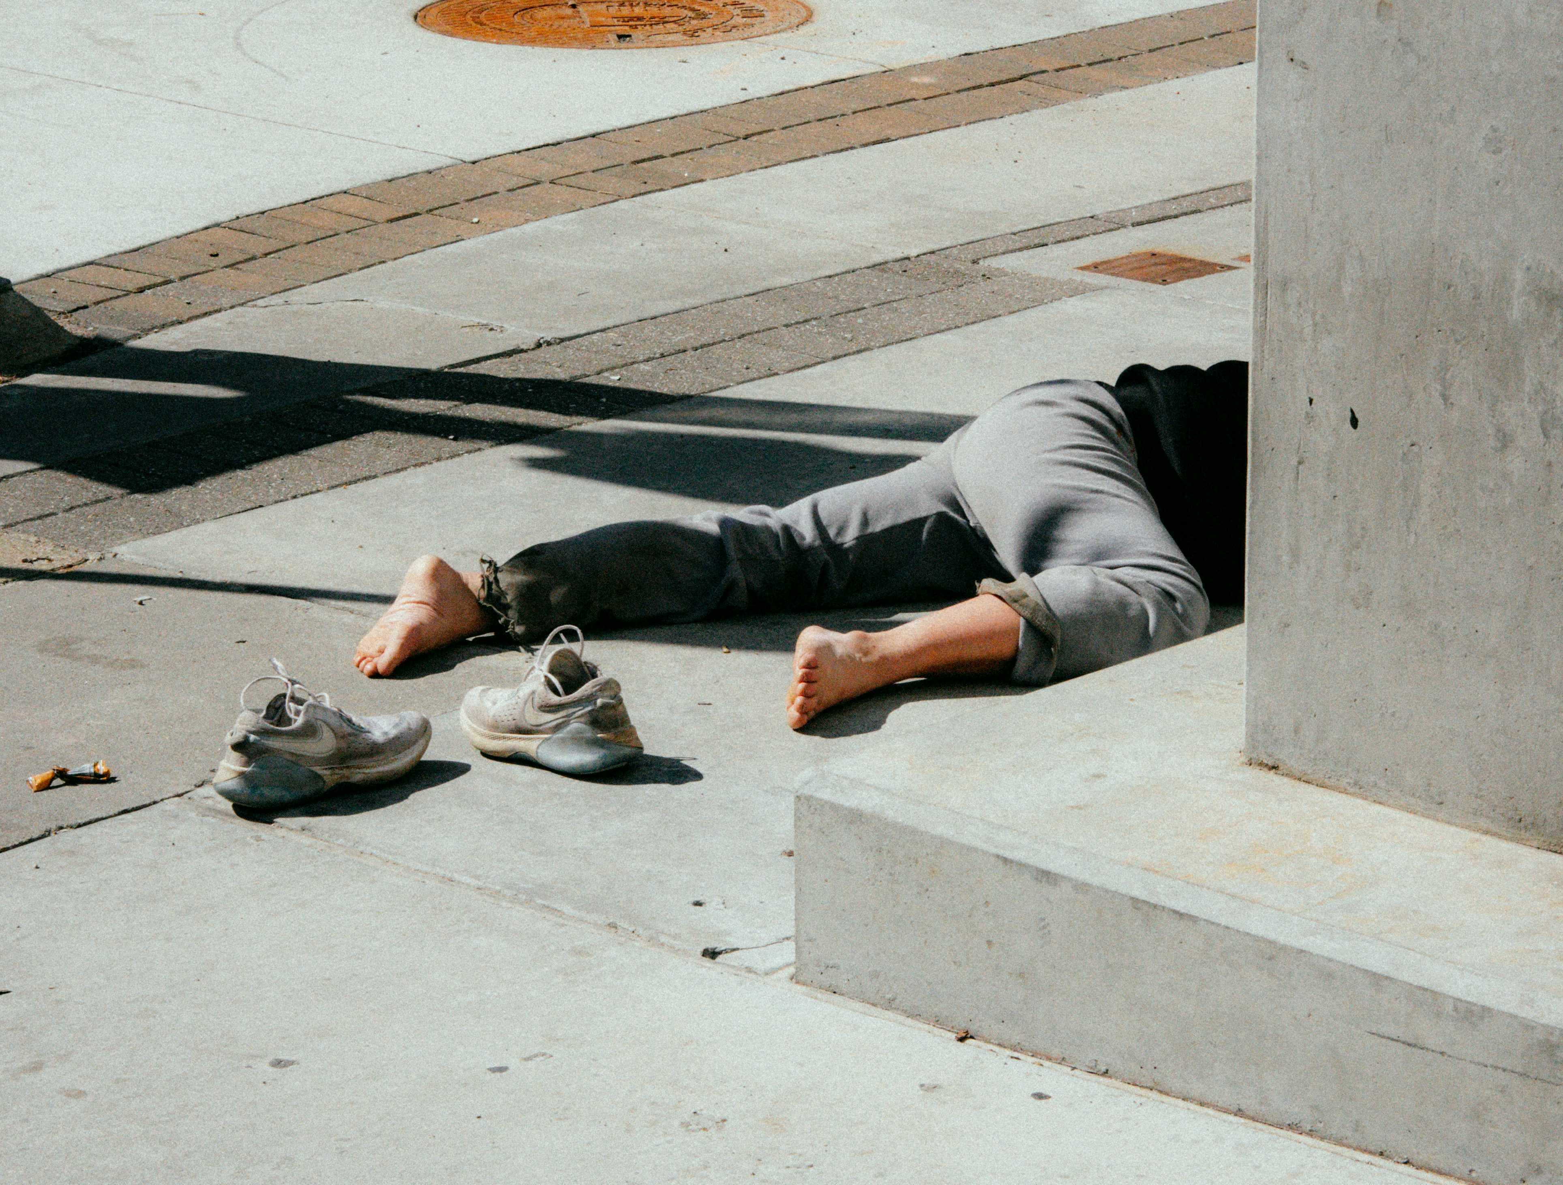
4. 結果

Slide 12
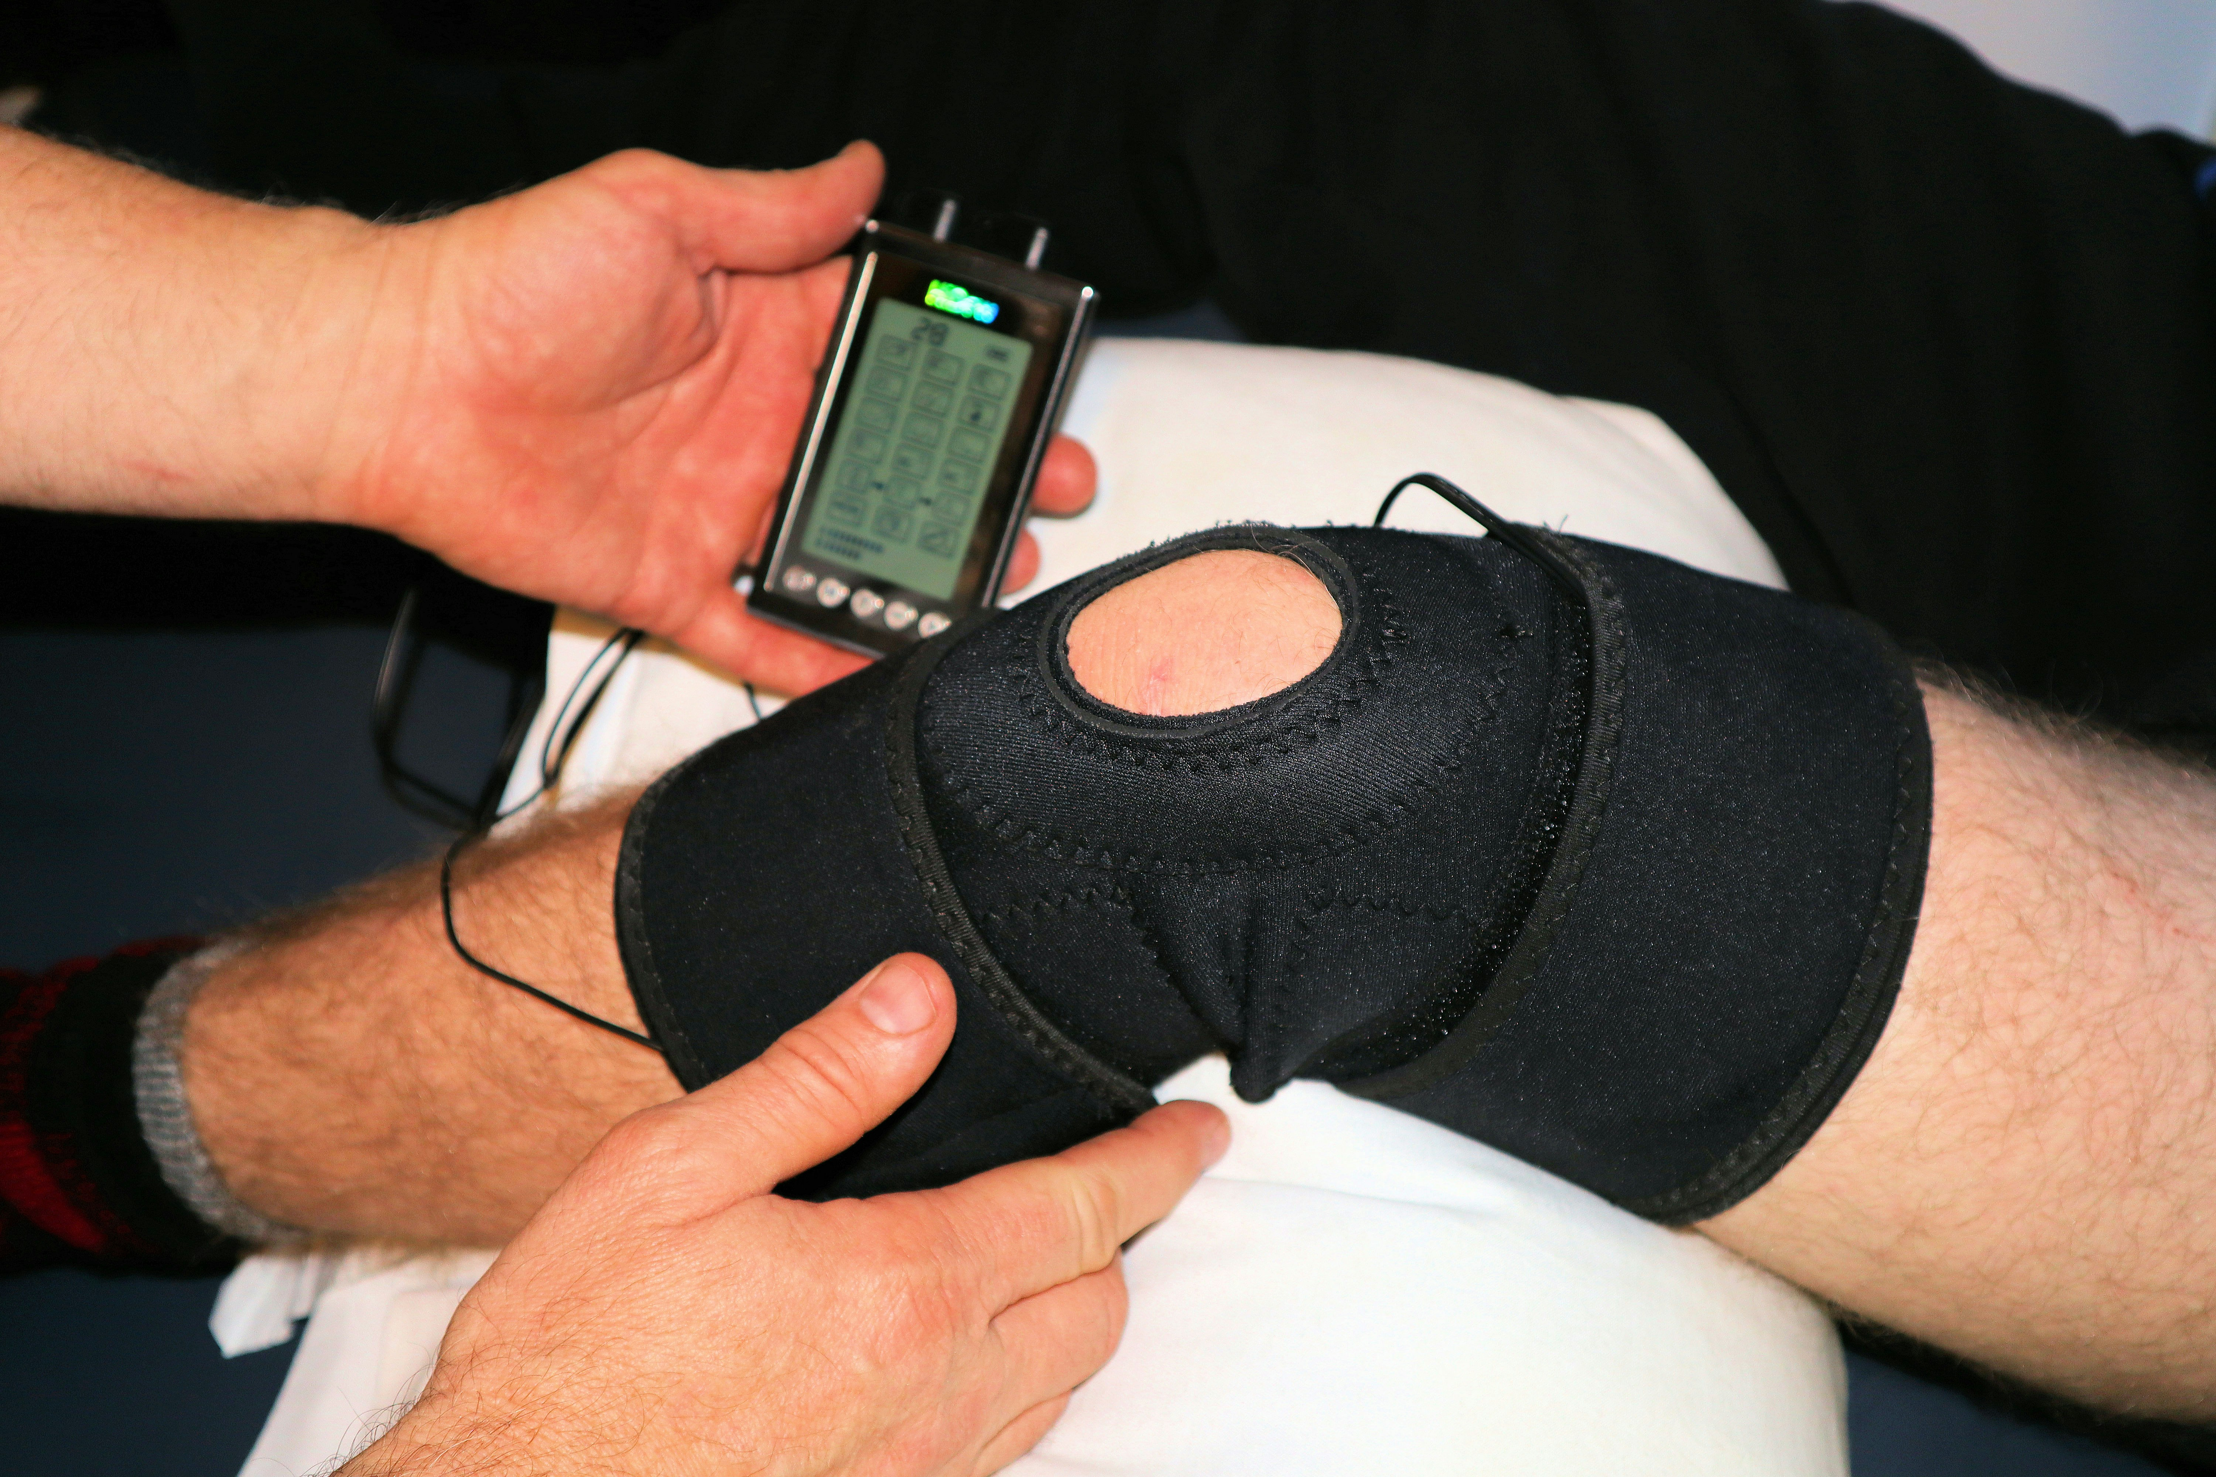

Slide 13
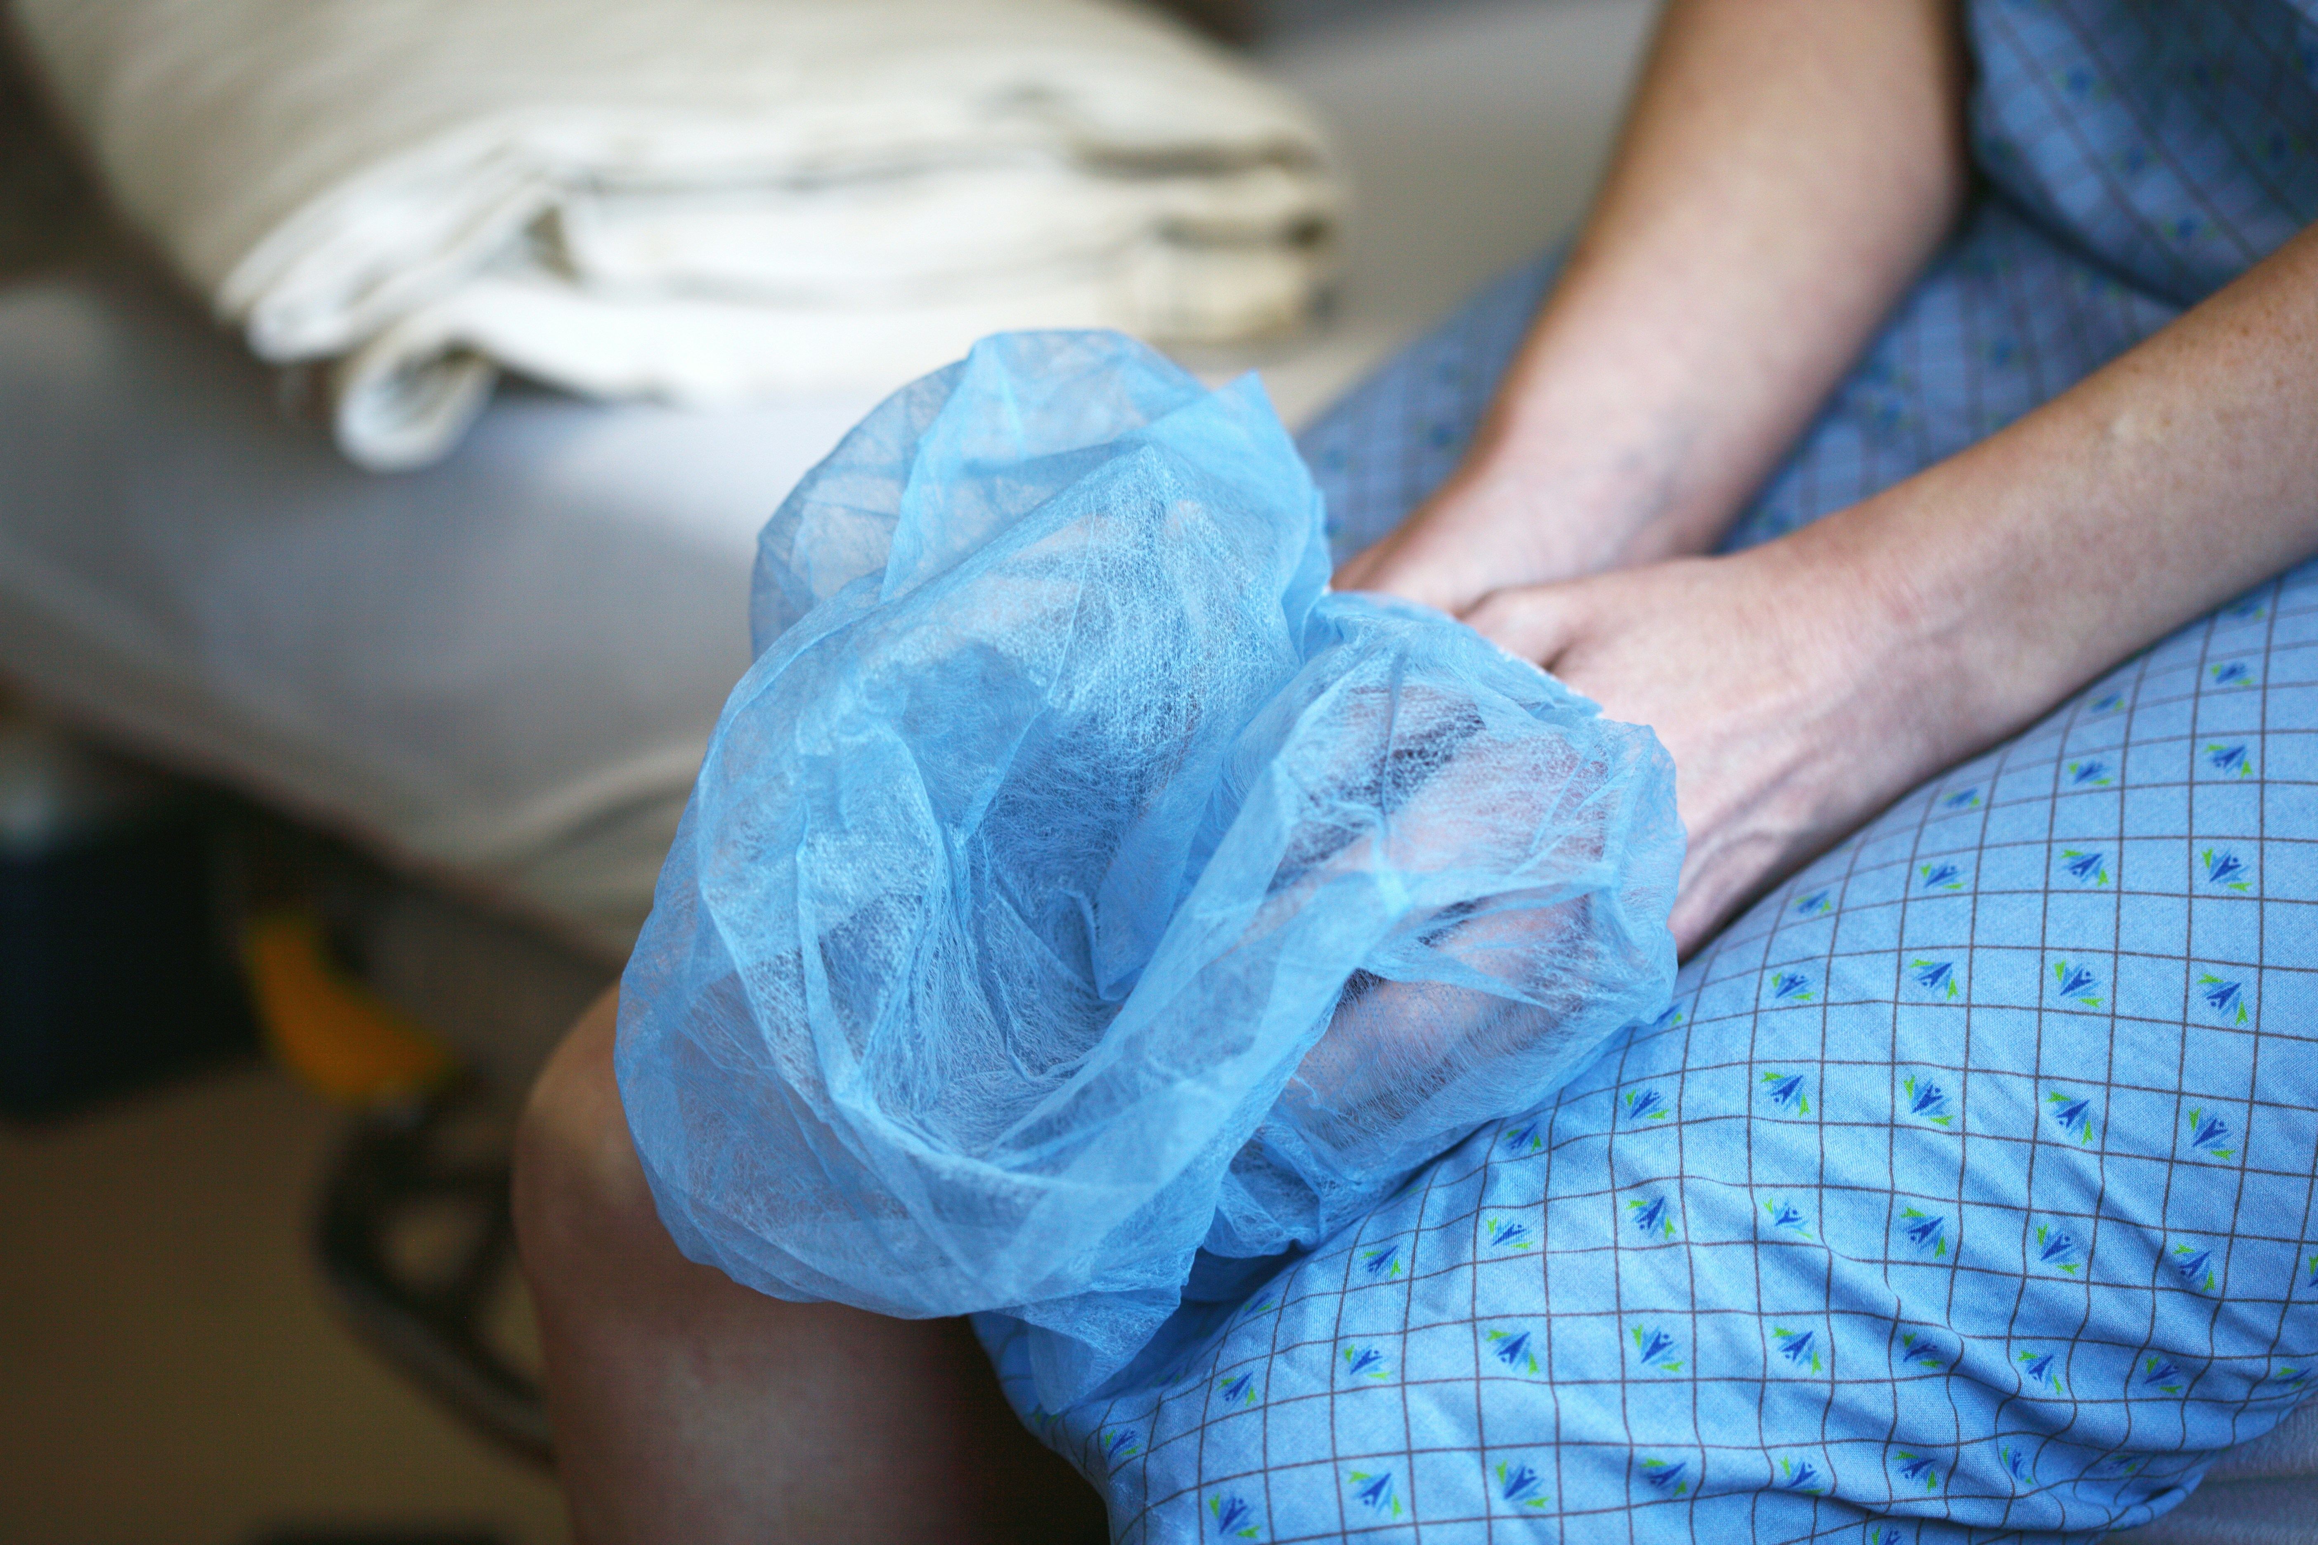
Notes:
https://unsplash.com/photos/person-in-blue-and-white-plaid-shorts-O6LZ3j_fK88?utm_content=creditShareLink&utm_medium=referral&utm_source=unsplash

Slide 14

5. 意外

Slide 15

Notes:
https://unsplash.com/photos/grayscale-photo-of-sleeping-woman-lying-on-bed-5NzOfwXoH88?utm_content=creditShareLink&utm_medium=referral&utm_source=unsplash

Slide 16
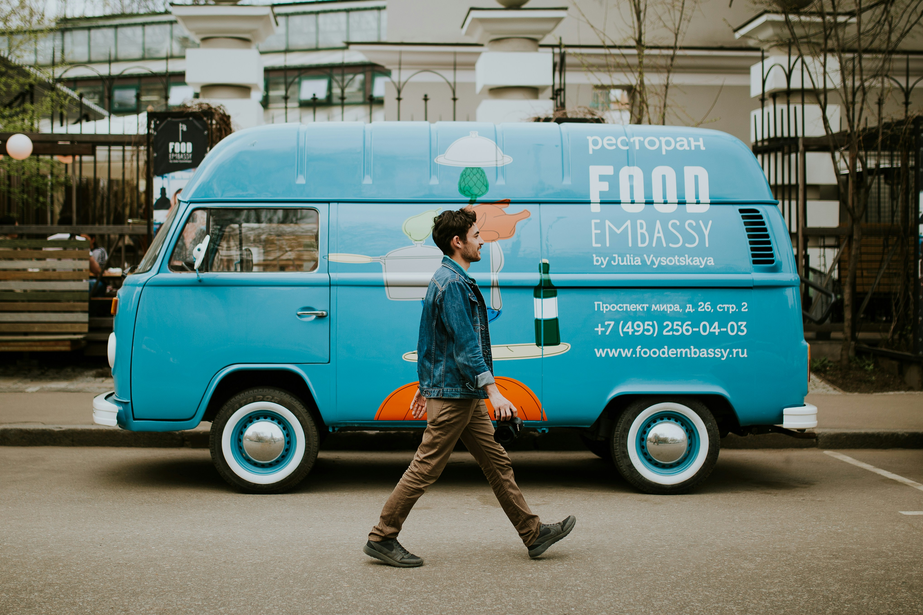
Notes:
https://unsplash.com/photos/man-walking-beside-van-near-concrete-house-FlLHbmF3AHc?utm_content=creditShareLink&utm_medium=referral&utm_source=unsplash

Slide 17

6. 轉彎

Slide 18
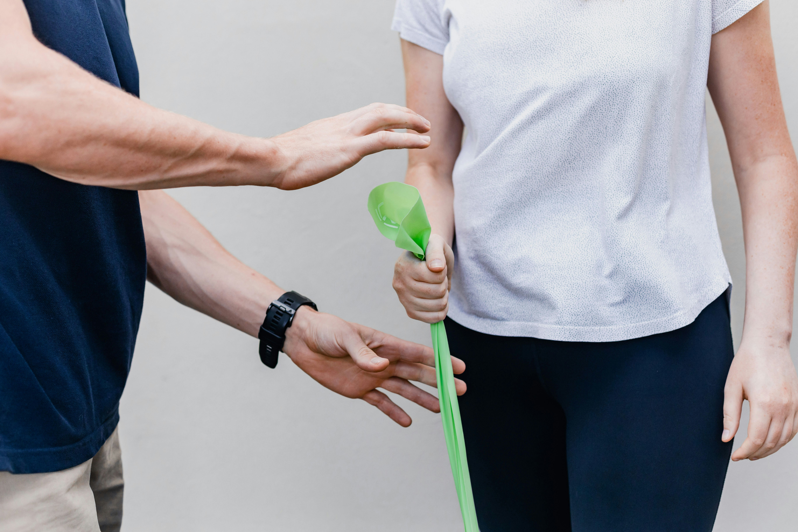

Slide 19


Slide 20

7. 結局

Slide 21
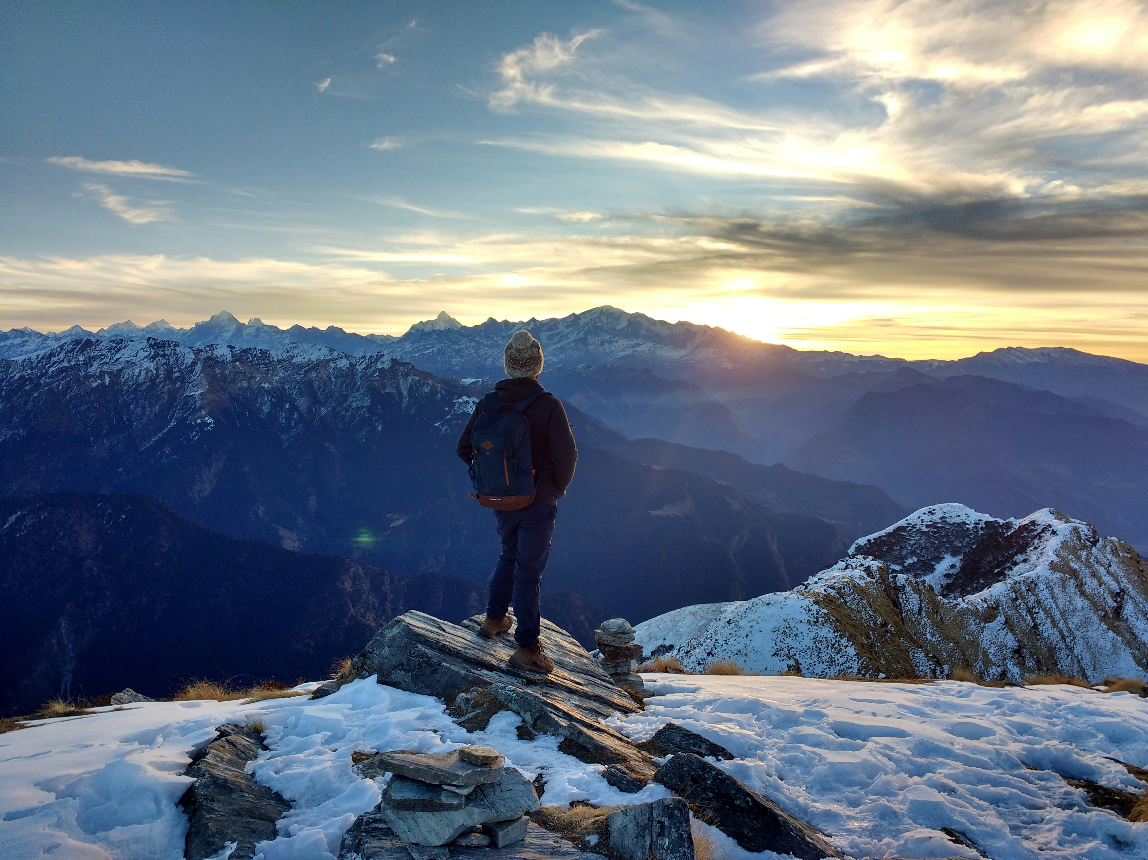

Slide 22
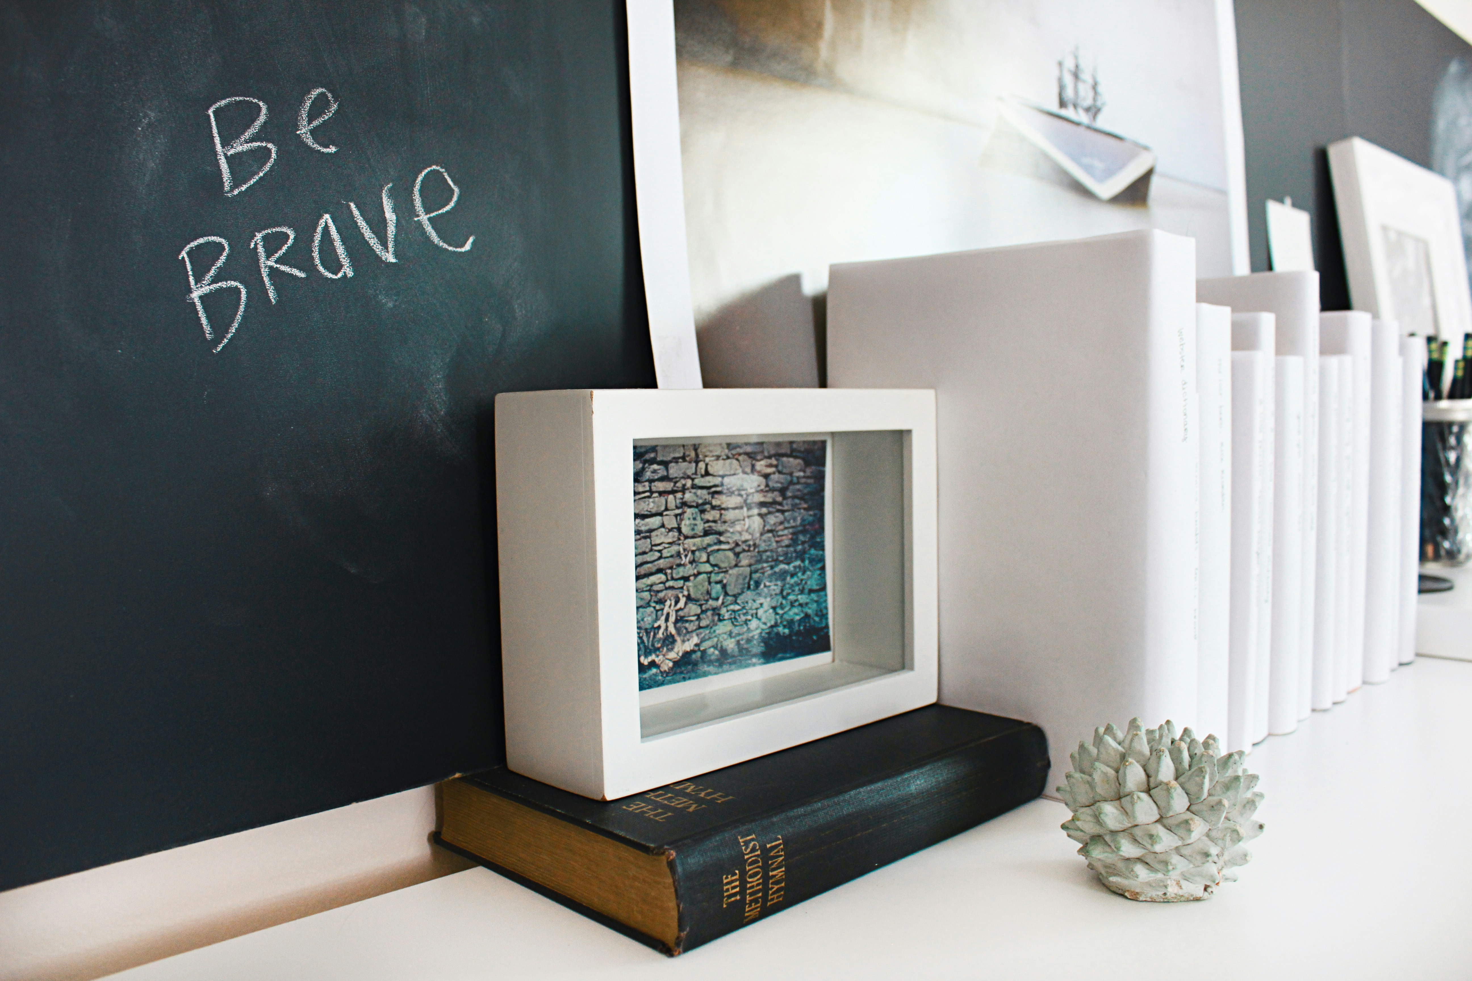
Notes:
https://unsplash.com/photos/hardbound-book-near-wall-Th4AD-YDEjI?utm_content=creditShareLink&utm_medium=referral&utm_source=unsplash

